Slide 1
Creating a Simple Game in XNA
James McLellan

Slide 2
Synopsis
Getting Started
  Where to get XNA, Where to get example code
Super Simple Side Scroller
  Starting an XNA Project, Building Graphic Assets, Loading Textures, Timing and Timers, Animation, Handling Keyboard and Gamepad Inputs
Main Menu
  Fonts, Music
Enemies
  Collision Detection

Slide 3
Getting Started
Download and Install XNA
  Visual Studio 2008
    http://www.microsoft.com/en-us/download/confirmation.aspx?id=39
  Visual Studio 2010
    http://www.microsoft.com/en-us/download/details.aspx?id=23714
Example Code
    http://fillthisinlater/

Slide 4
Getting Started
Creating a new project
  Start -> XNA Game Studio -> Visual Studio 2008 (or 2010)
  New Project
    XNA Game for Windows
    Methods Created for You:
      Load Content
      Update
      Draw

Slide 5
Super Simple Side-Scroller
LoadContent
Update
  Key/Joystick Inputs
Draw

Slide 6
Super Simple Side-Scroller
Creating 2D Content
  Royalty Free or Build Your Own:
    Level Background - desert
    Hero - mario
    Enemies - goomba
      Pay attention to licensing
  Build Your Own:
    Add Alpha
      Gimp:
        Toolbox -> Select by Color
        Layer -> Transparency -> Add Alpha Channel
        Toolbox -> Eraser
    Animation
      Gimp:
        Image -> Flip Horizontally (Goomba)

Slide 7
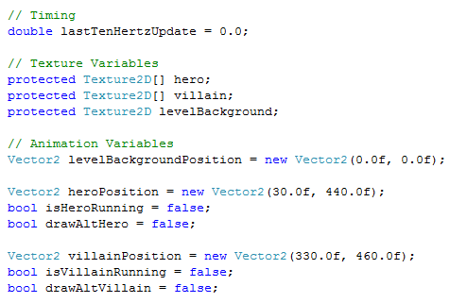
Super Simple Side-Scroller
Private Variables
Notes:
We will need variables to hold our graphics content.
First we have a timer to constrain our animation frame rate to some desired rate, in this case 10Hz.
Then the texture variables for the hero, the villain, and the level background.
And last some location information for the starting position of these three textures.

Slide 8
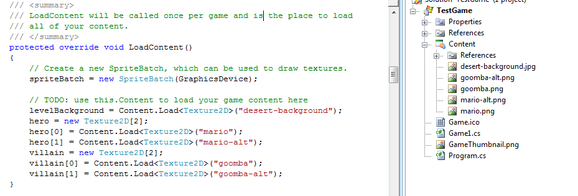
Super Simple Side-Scroller
LoadContent
Notes:
Right-click on the content folder in your solution explorer to add your images.
The loaded image is automatically assigned an identifier, which is usually the image name, with the file extension stripped off, so that “desert-background.jpg” becomes just “desert-background”
The images then need to be explicitly associated with your variables. This is done in the LoadContent() method by calling Content.Load and providing the image id and type.

Slide 9
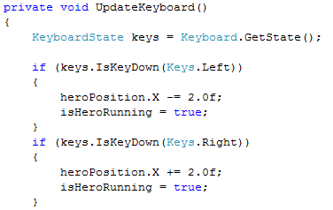
Super Simple Side Scroller
Update
  UpdateInputs
    UpdateKeyboard()

Slide 10
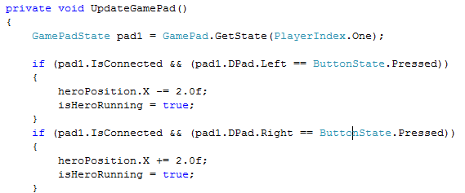
Super Simple Side Scroller
Update
  UpdateInputs
    UpdateGamePad()

Slide 11
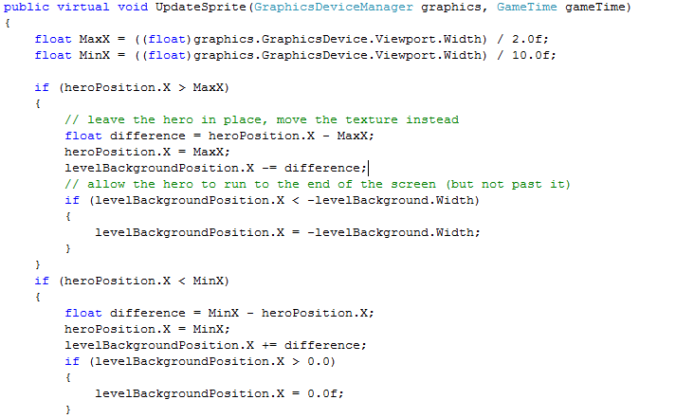
Super Simple Side Scroller
Update
  UpdateSprite

Slide 12
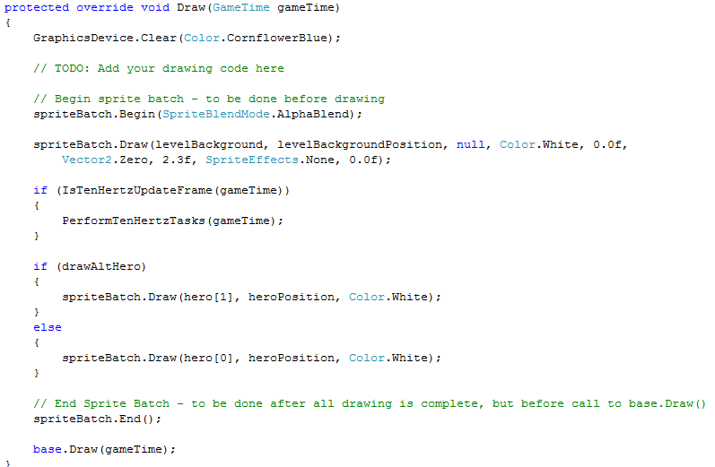
Super Simple Side Scroller
Draw

Slide 13
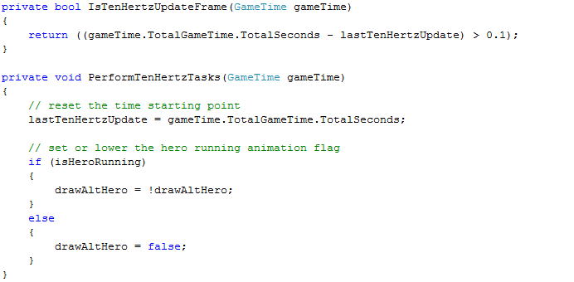
Super Simple Side Scroller
Animation Timing

Slide 14
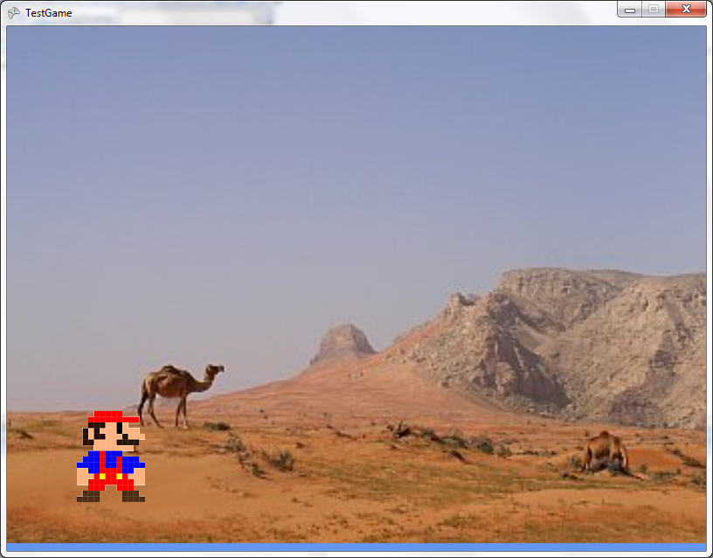
Super Simple Side Scroller
Result

Slide 15
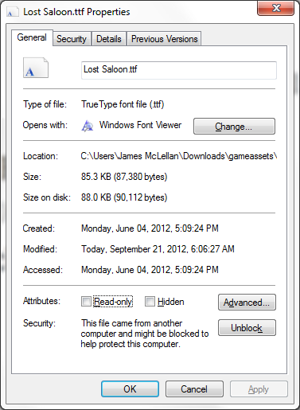

Main Menu
Find a Font
  http://www.dafont.com/
Unblock and Install Font

Slide 16
Main Menu
Add Font to Game
  Create a new SpriteFont
  Modify SpriteFont
  LoadContent
  Draw

Slide 17
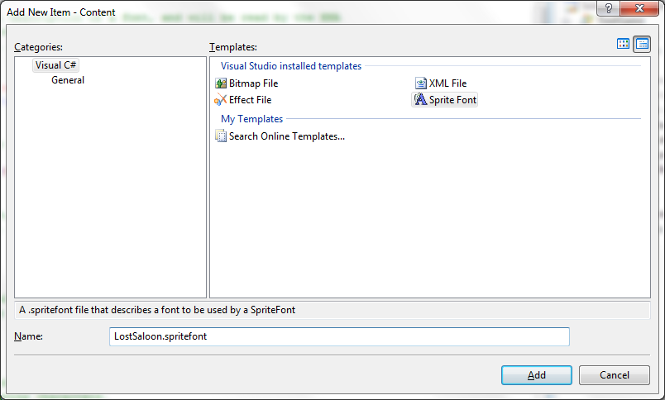
Main Menu
Add Font to Game
  Create a new SpriteFont

Slide 18
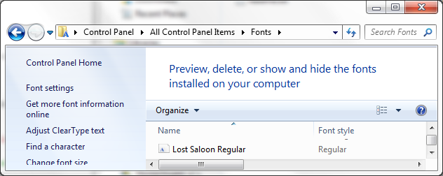
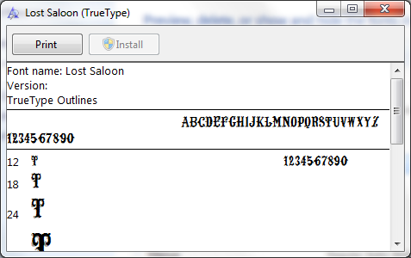

Main Menu
Add Font to Game
  Verify font name in Control Panel -> Fonts
  Modify Spritefont
      Restarting Visual Studio may be required after installing a new font, for the font to be recognized

Slide 19


Main Menu
Add a Font to the Game
  Variables
  LoadContent
  Draw

Slide 20
Main Menu
Background
Music
Update
  Update Key/Gamepad Inputs
  Debounce
Draw

Slide 21
Main Menu
Background
  Load a sprite, as done for side scroller
Music
  Create your own, or purchase
  Music resource:
    http://openmusicarchive.org/
  Sound Effect resource:
    http://www.freesound.org/

Slide 22

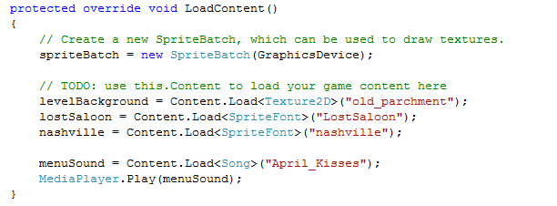
Main Menu
Music
  Variables
  LoadContent
  Play

Slide 23
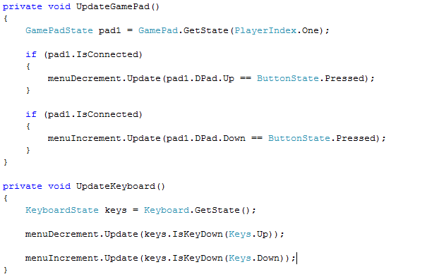
Main Menu
Update
  Update Key/Gamepad Inputs
  Debounce

Slide 24
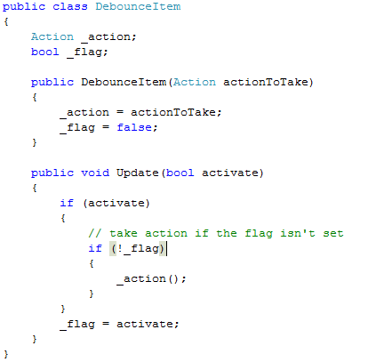
Main Menu
Update
  Debounce
Draw

Slide 25
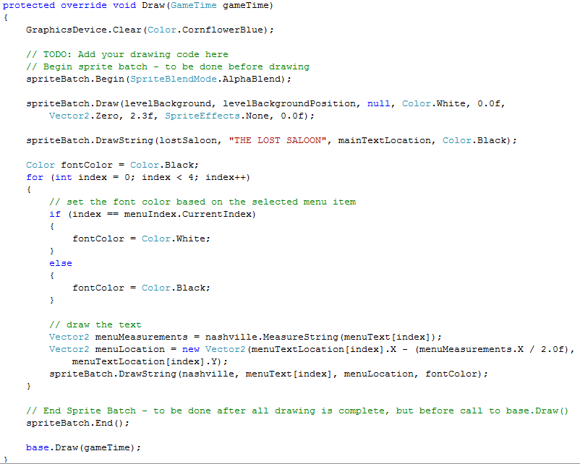
Main Menu
Draw

Slide 26
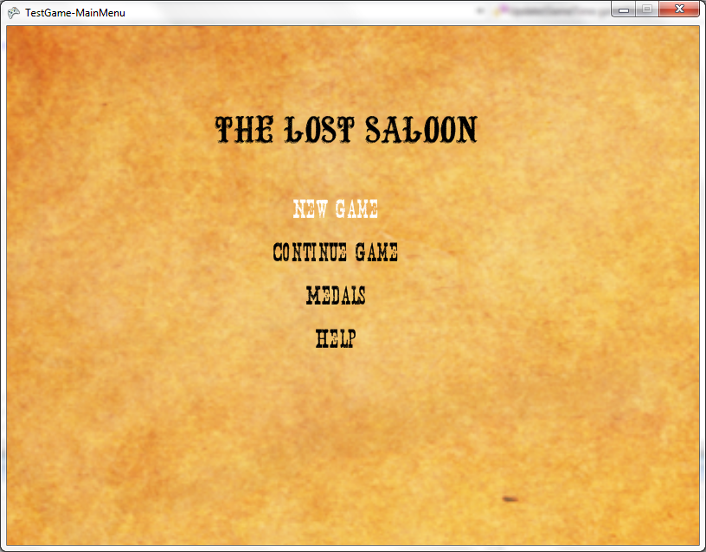
Main Menu
Result

Slide 27

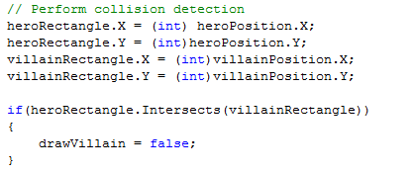
Enemies
Collision Detection
  Create bounding box rectangles in LoadContent
  Test for collision in Update

Slide 28
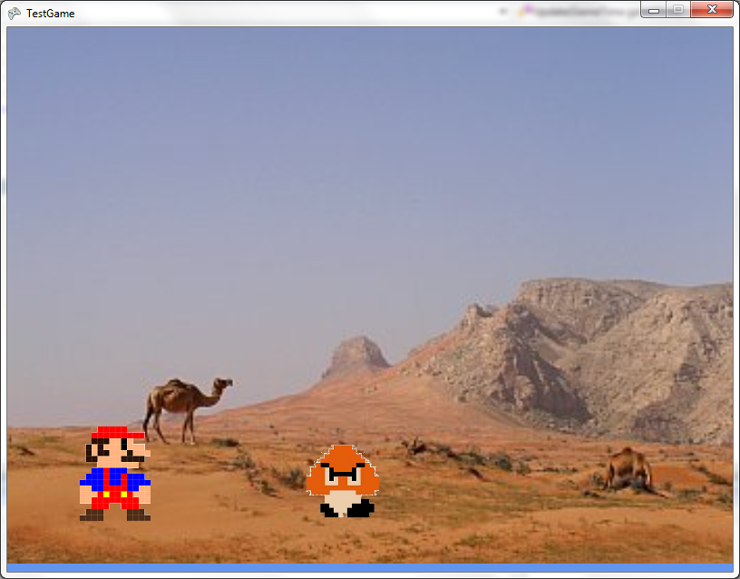
Enemies
Result

Slide 29
Contact Information
For questions, examples
  james.mclellan@gmail.com

